Slide 1
Contents
What is Docker and why we need it?
Installation and configuration
Running the first docker container
Deploying Jenkins as a docker container.
Most commonly used docker commands
Difference between Image and Container
Docker’s Architecture

Slide 2
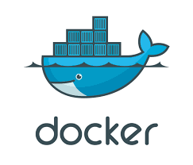
What is Docker?

Slide 3
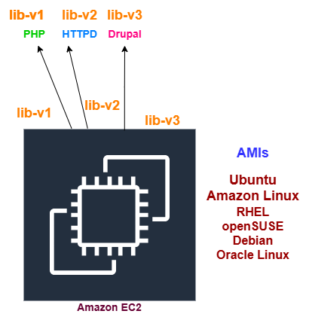
Deploying an App without Docker

Slide 4
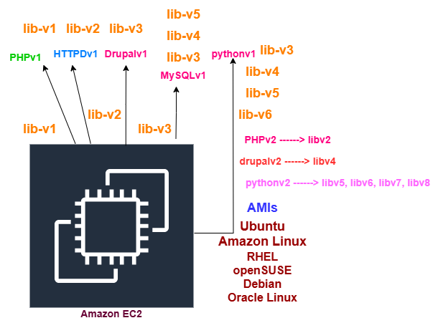
Deploying an App without Docker (2nd Scenario)

Slide 5
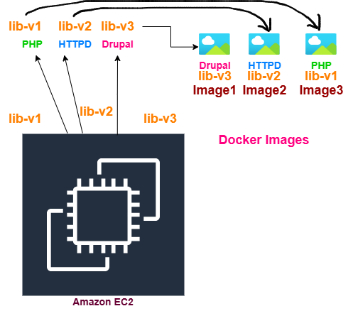
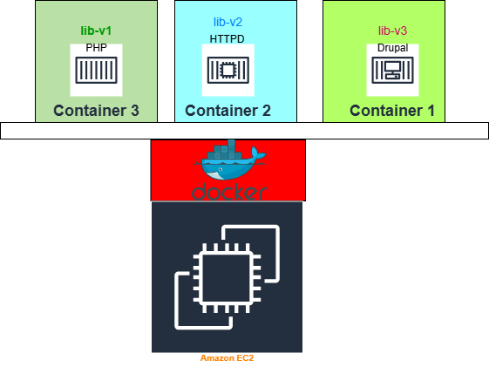
Deploying an App with Docker
Image3
Image2
Image1

Slide 6
Install and Configure Docker
Install docker on Ubuntu: https://docs.docker.com/engine/install/ubuntu/
sudo systemctl status docker
docker ps
docker ps -a
sudo usermod -aG docker ubuntu
docker run -d -p 8080:8080 --restart=on-failure jenkins/jenkins:lts-jdk17
docker exec 54724b1adf85 cat /var/jenkins_home/secrets/initialAdminPassword

Slide 7
Most common docker commands 1
# Create and start a new container from an image
docker run
# Start, Restart or Stop one or more stopped containers
docker start / docker stop / docker restart
# Remove one or more containers
docker rm
# Run a command in a running container
docker exec
# Fetch the logs of a container.
docker logs
# List running/all containers
docker ps / docker ps –a
# Build an image from a Dockerfile
docker build

Slide 8
Most common docker commands 2
# Pull an image or a repository from a registry
docker pull
# Push an image or a repository to a registry
docker push
# List images
docker images
# Remove one or more images
docker rmi
# Create a tag TARGET_IMAGE that refers to SOURCE_IMAGE.
docker tag SOURCE_IMAGE[:TAG] TARGET_IMAGE[:TAG]
# Display a live stream of container(s) resource usage statistics
docker stats
# Show docker disk usage
docker system df

Slide 9
Most common docker commands 3
# Show the history of an image
docker history [OPTIONS] IMAGE
# Return low-level information on Docker objects
docker inspect
# List volumes
docker volume ls
# Create a new volume
docker volume create
# Display detailed information on one or more volumes.
docker volume inspect
# Remove one or more volumes
docker volume rm
# Remove all unused containers, networks, images
docker system prune

Slide 10
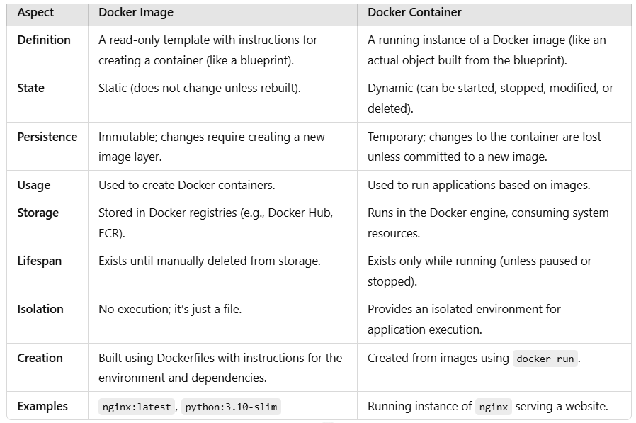
Docker Image Vs Docker Container

Slide 11
Docker Image/Container/Registry
A Docker registry (https://hub.docker.com/) stores Docker images. Example: Docker Hub.
An image is a read-only template with instructions for creating a Docker container.
A container is a runnable instance of an image.

Slide 12
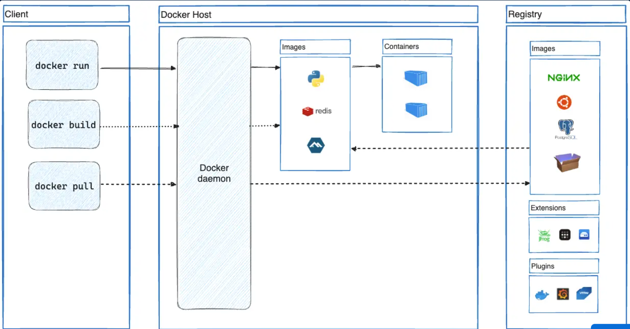
Docker’s Architecture
Docker follows client-server architecture

Slide 13
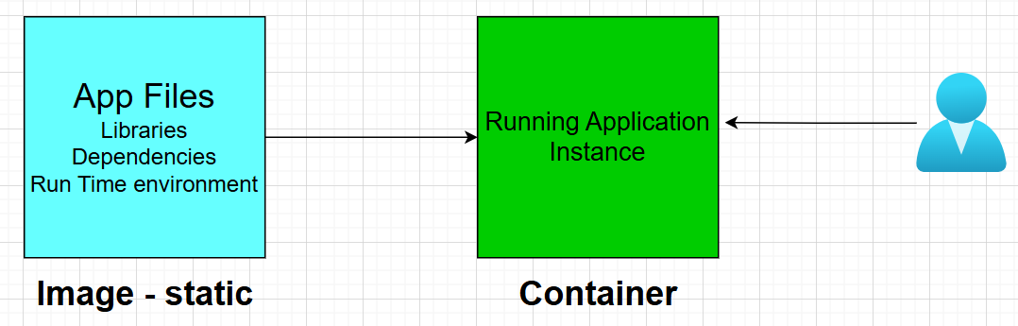
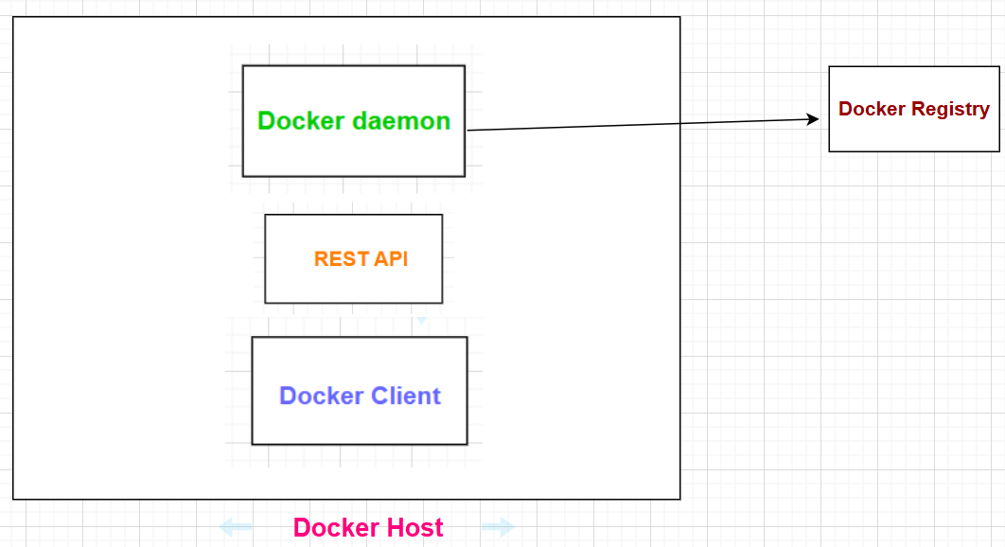
Docker’s Architecture (Contd.)

Slide 14
Docker’s Architecture (Notes)
The Docker client and daemon communicate using a REST API.
The Docker client talks to the Docker daemon (dockerd), which does the heavy lifting of building, running, and distributing your Docker containers. The Docker client and daemon can run on the same system, or you can connect a Docker client to a remote Docker daemon.

